Slide 1
Unsupervised Learning
By: Brandon Shumin
ECE 6420

Slide 2
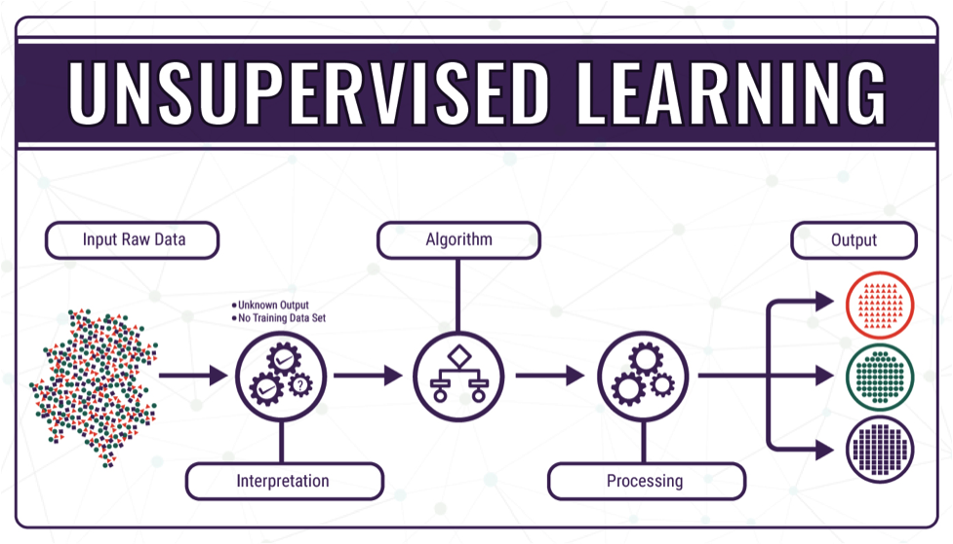
Unsupervised Learning in General
Qualities of unsupervised learning models:
Able to be trained on unlabeled data
Excels at clustering groups of unlabeled data
Two main methods of unsupervised learning include:
Principal component analysis (PCA): computes principal components to perform a change of basis on the data; great for dimension reduction
Cluster analysis: finds commonalities in data sets to categorize by; good for anomaly detection
Notes:
Generally preferred when labeled data is difficult to obtain or inefficient

Slide 3
Research Background – Overview
Sources and topics covered:
Unsupervised learning for network traffic, anomaly detection, and network optimization (Usama, 2017)
Unsupervised learning for determining ego-motion from video (Zhou, 2017)
Unsupervised learning for determining 3D structures from 2D images (Rezende, 2016)

Slide 4
Unsupervised Machine Learning for Networking: Techniques, Applications and Research Challenges
Usama, M., Qadir, J., Raza, A., Arif, H., Yau, K. A., Elkhatib, Y., Hussain, A., & Al-Fuqaha, A

Slide 5
Research Background – Networking
Survey to provide insight into uses of unsupervised learning in the field of networking. Specifically the following categories:
Traffic engineering/classification – organizing internet traffic into specific traffic classes based on factors such as port number or incoming protocol
Examples of unlabeled data used in traffic classification are sensitive traffic, best-effort traffic, and undesired traffic
Anomaly detection – detection of possible malicious security threats to a network
Some anomalies include IP spoofing, MAC spoofing, and bandwidth anomalies
Quality of service (QoS) optimization – using efficient resource allocation to provide best possible user experience on a given network
QoS metrics include bit rate, error rates, throughput pf the network, transmission delay, resource availability, etc.
(Usama, 2017)

Slide 6
Networking – Traffic Engineering/Classification
K-Means Clustering
Clusters m datapoints into n clusters with datapoints classified into the nearest cluster
Can be used in conjunction with supervised learning to add outlier detection to a single model
90% classification accuracy experimentally
Latent Variable Models (LVM)
Great for dimensionality reduction which can improve performance and reduce risk of overfitting through inference of latent variables from observable variables
Since different types of traffic have different characteristics, this method easily identifies categories through the latent variable signatures these types of traffic have
Used on network packet stream data, LVM can detect types of “traffic flows” and the underlying characteristics of how traffic is being sent to ascertain the type of traffic being observed
(Usama, 2017)
Notes:
PCA = Principle Component Analysis
Latent Variable Model works by converting observable variable into inferred latent variables, thus reducing dimensionality.
Types of traffic: Sensitive traffic, best-effort traffic, and undesired traffic

Slide 7
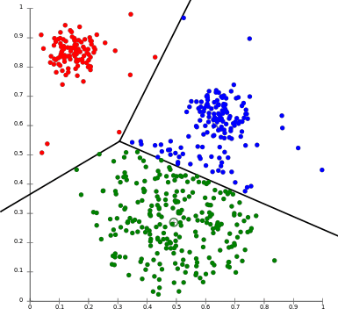
K-Means Clustering
Notes:
Explain a bit about how K-Medoids could look here

Slide 8
Networking – Anomaly Detection
Dimensionality reduction such as PCAs are recommended to ease cost of feature extraction. This helps with separating anomalous traffic from normal traffic signatures.
Manifold Learning
Can be supervised, but unsupervised in this case is desirable due to volume of the data and the high-dimensionality of data. Also helps with dimensionality reduction
Principle Curves can be used to probabilistically determine which points are likely to be outliers within the data when considering Gaussian noise
Isomaps search for the lower-dimensional embeddings that keep the same distance between all data points, this is also a valid approach for outlier detection
Clustering
K-Means also viable when used as K-Mediods, where a central median point of the cluster is considered for detecting points in a cluster, making outlier detection easier
(Usama, 2017)
Notes:
Deep Packet Inspection (DPI) recommended for handling encrypted data.
Principal curves is a nonlinear dataset summarizing technique where non-parametric curves passes through the middle of multi-dimensional dataset providing the summary of the dataset. These smooth curves minimize the average squared orthogonal distance between data points, this process also resembles to the maximum likelihood for nonlinear regression in the presence of Gaussian noise.
Manifold learning is an approach to non-linear dimensionality reduction. Algorithms for this task are based on the idea that the dimensionality of many data sets is only artificially high.

Slide 9
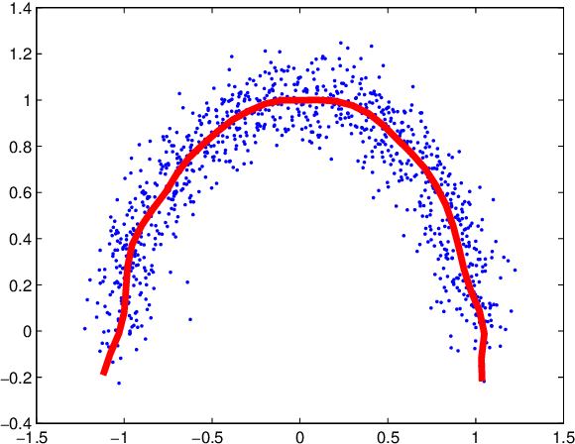
Principle Curve

Slide 10
Networking – Quality of Service
Deep Neural Networks (DNNs)
Used heavily in determining resource allocation when resources are scarce
Hybrid NNs using multiple trained models are also recommended to combine the advantages of multiple models (see below)
These models excel at predicting traffic volume in a network at runtime, which allows for predictive resource allocation
Convolutional Deep Belief Network
Composed of multiple layers of NNs that scale extremely well with data sets of high-dimensions, as QoS has
Allows for the most probabilistically productive action to be taken by the network to improve QoS, which, on average, should improve the network’s QoS performance
(Usama, 2017)

Slide 11
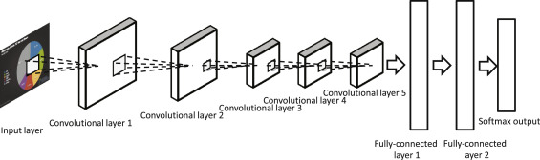
CDBN

Slide 12
Conclusions – Networking
Clustering offers valuable solutions to both Traffic Classification and Anomaly Detection problems through K-Means/K-Mediods clustering.
K-Means is an extremely effective (90% correct) way to cluster network traffic
K-Mediods offers a similar approach to K-Means for outlier/anomaly detection
Simplicity of these models makes them desirable for implementation, however the amount of expected clusters must be known for these methods
Manifold Learning offers an alternative to Anomaly Detection
Principle curves and Isomaps allow for easier outlier identification without incorporation of supervised learning to K-Means or use of K-Mediods, which can have variability due to the initial k-mediods being randomly chosen
Quality of Service improvements are restricted to NNs for the most part due to the complex nature of the features required to make accurate adjustments/predictions.
Notes:
Types of traffic: Sensitive traffic, best-effort traffic, and undesired traffic
Manifold learning is better than clustering for linear frameworks from non-linear datasets (treating non-linear data as linear data).

Slide 13
Unsupervised Learning of Depth and Ego-Motion from Video
Zhou, T., Brown, M., Snavely, N., & Lowe, D. G. (2017). Unsupervised Learning of Depth and Ego-Motion from Video

Slide 14
Research Background – Ego-Motion
Ego-motion: motion of a camera in 3-dimensions within an environment
In this case, we care about the motion of object within a camera’s view in 3-dimensions
Unsupervised learning offers an alternative approach to this problem over geometric view synthesis without requiring a ground-truth to train.
This unsupervised model consists of 2 CNNs
A depth CNN for determining the depth of objects in the image
A pose CNN for determining change in motion between frames
Note that these two CNNs are trained separately and can be used individually
(Zhou, 2017)

Slide 15
Ego-Motion
Approach:
Train 2 independent CNNs to determine pose and depth of a scene, and predict camera motion (ego-motion) and detect objects between scenes
Only cameras with known calibrations and types may be used to simplify modeling, but restricts use of many videos
Advantages Over Existing Methods:
Current schemes using geometric computer vision fail to work with scenes where non-rigidity or lack of texture
Decoupling of the CNNs allows for possible independent applications of the unique CNNs for other projects
Much improved performance over geometric computer vision
(Zhou, 2017)

Slide 16
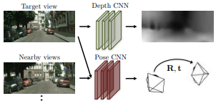
Ego-Motion Approach

Slide 17
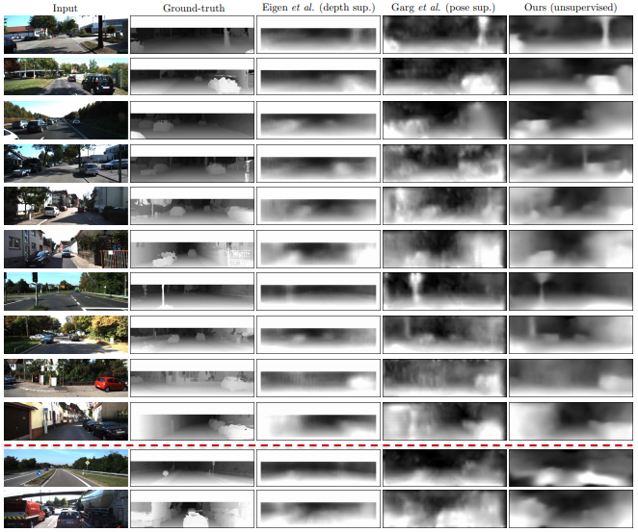
Ego-Motion Results
Notes:
Depth View
Bottom two rows show typical failures caused by open scenes or objects close to the front of the camera
Important to note that Ground truth only used for comparison

Slide 18
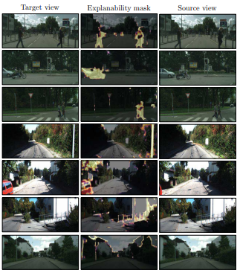
Ego-Motion Results
Notes:
Pose Results
Highlighted pixels are predicted to be unexplainable by the network due to motion (rows 1–3), occlusion/visibility (rows 4–5), or other factors (rows 7–8).

Slide 19
Conclusions – Ego-Motion
An end-to-end learning model was created that utilizes pose and depth without labeled data or ground truth data for training.
The model does fall short of some current supervision models but is still comparable in terms of accuracy except in more fringe cases.
Occlusion, independent motion, and various other factors can create large errors in the network especially with respect to the pose CNN
The failure of the model with objects near the camera as well as with vast open spaces is an area where the authors seek to improve in the future
Overall, while the model fails in a few areas, the researchers believe that the model’s performance compared to current models is noteworthy and perhaps even more usable due to the lack of labeled data required.

Slide 20
Unsupervised Learning of 3D Structure from Images
Rezende, D. J., Eslami, S. M. A., Mohamed, S., Battaglia, P., Jaderberg, M., & Heess, N

Slide 21

Research Background – 3D Structures from Images
Having the ability to understand 3D structures in a ML context is invaluable as it allows for abstracting away complex relations in a 2D image.
The steps for training the models in this paper were as follows:
Using generative models to create 3D structures (some from the MNIST3D dataset)
Use conditional training to infer plausible 3D structures given a 2D image of the generated object
Ensure training can be completed end-to-end with unlabeled 2D data with no ground truth
To achieve the above results, the model is first tested on reconstructing volume on 3D objects and then inference from 2D images is later trained.
(Rezende, 2016)

Slide 22
3D Structures from Images
Sequential generative models were used to create 3D structures to train off at different poses.
The model was initially trained using Necker Cubes of size, primitive shapes of size, and MNIST3D objects.
The Necker Cubes were always positioned such that one corner overlapped another to prove depth perception of the model was correct
Primitives and MNIST3D images were rotated randomly within a range to train for different poses
Both volume models created from the sequential generative model and mesh models from the OpenGL library were tested separately using conditional.
The unsupervised model of choice for this research was probabilistic inference. Stochastic gradient descent was also used on the model to smooth the prediction and improve performance.
(Rezende, 2016)
Notes:
From their notes, this MNIST3D dataset was generated by the team by extruding the MNIST dataset.
All rotations are applied at the time of testing.

Slide 23
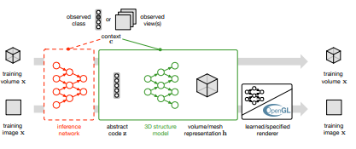
3D Structures from Images – Model

Slide 24
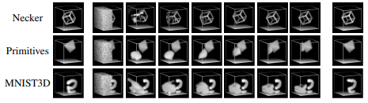
3D Structures from Images – Generative Data
Notes:
Utilization of probabilistic volume completion
Left column is 100th iteration of generative model

Slide 25
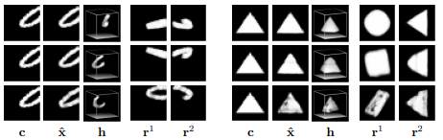
3D Structures from Images – Results
Notes:
Volume representation

Slide 26
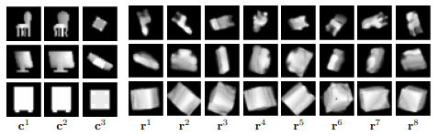
3D Structures from Images – Results

Slide 27
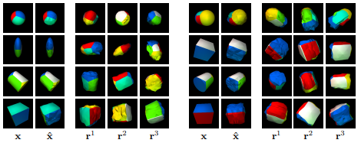
3D Structures from Images – Results
Notes:
Mesh Representation

Slide 28
Conclusions – 3D Structures from Images
Volume Representations
Flexible and can capture a larger variety of objects (i.e. chairs and computer examples)
Computationally intensive due to higher dimensionality vs. mesh
Mesh Representation
Significantly smaller range of shapes that can be modeled, generally primitives
Lower dimensionality, so higher rates of success and easier to train
Overall, reconstruction of 3D models from snapshots of generated structures was successful with slightly better reconstruction being attributed to mesh models over volume models.
It is stated that testing with volume-to-mesh conversion algorithms would be of great interest to future research.

Slide 29
Questions/Comments?

Slide 30
Sources
Rezende, D. J., Eslami, S. M. A., Mohamed, S., Battaglia, P., Jaderberg, M., & Heess, N. (2016). Unsupervised Learning of 3D Structure from Images. https://proceedings.neurips.cc/paper/2016/file/1d94108e907bb8311d8802b48fd54b4a-Paper.pdf.
Usama, M., Qadir, J., Raza, A., Arif, H., Yau, K. A., Elkhatib, Y., Hussain, A., & Al-Fuqaha, A. (Sept 19, 2017). Unsupervised Machine Learning for Networking: Techniques, Applications and Research Challenges. https://arxiv.org/pdf/1709.06599.pdf.
Zhou, T., Brown, M., Snavely, N., & Lowe, D. G. (2017). Unsupervised Learning of Depth and Ego-Motion from Video. https://openaccess.thecvf.com/content_cvpr_2017/papers/Zhou_Unsupervised_Learning_of_CVPR_2017_paper.pdf.

Slide 31
References
https://en.wikipedia.org/wiki/Principal_component_analysis
https://en.wikipedia.org/wiki/Unsupervised_learning#:~:text=Unsupervised%20learning%20is%20a%20type,a%20minimum%20of%20human%20supervision
https://en.wikipedia.org/wiki/Traffic_classification#:~:text=Traffic%20classification%20is%20an%20automated,a%20number%20of%20traffic%20classes

